Slide 1
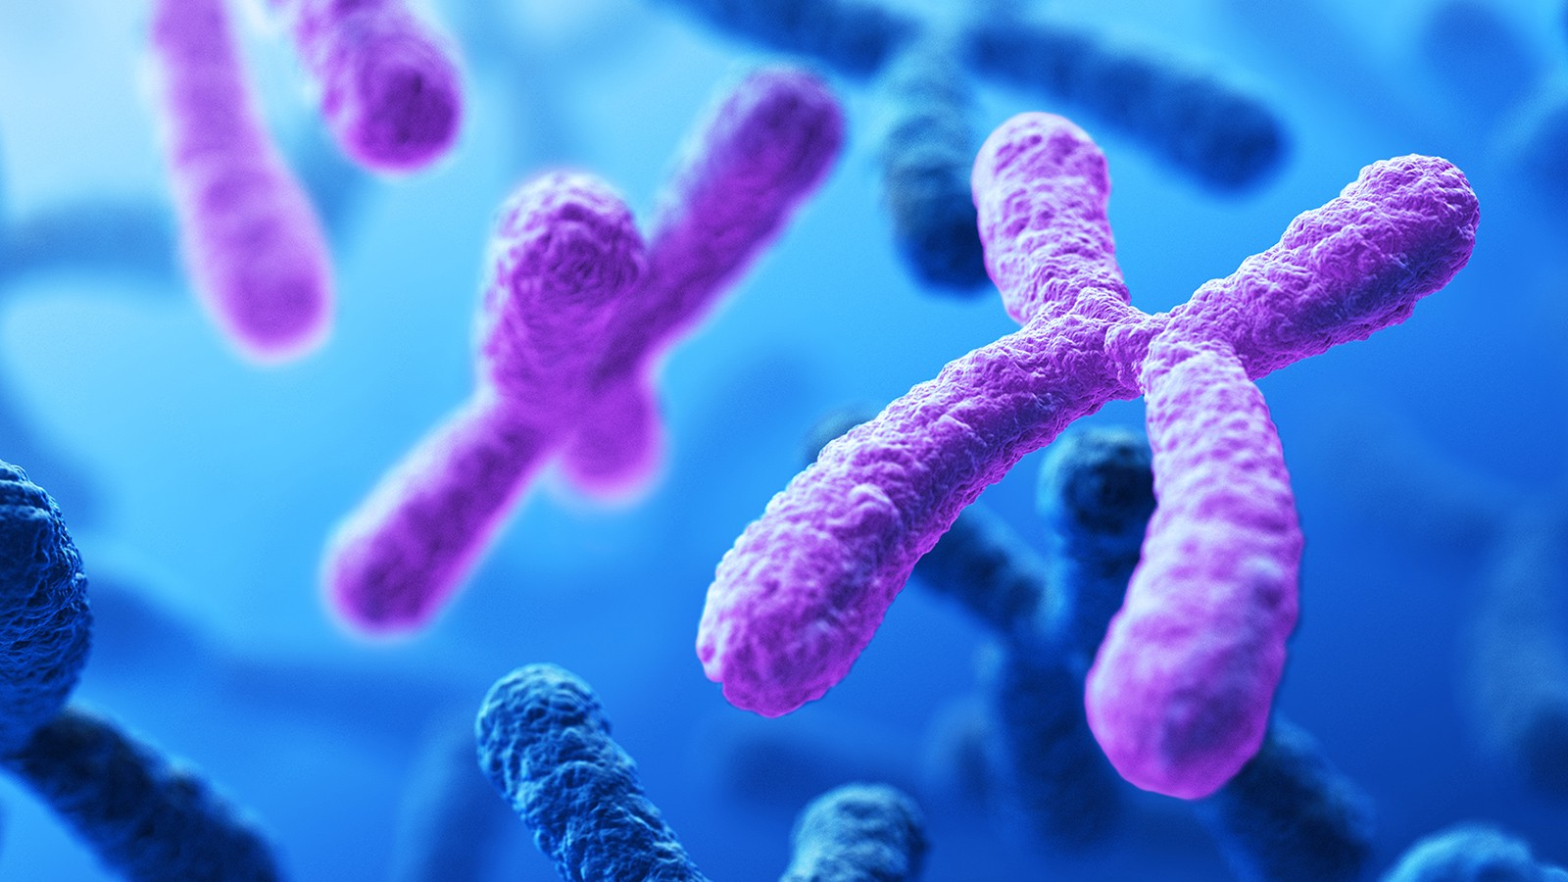
Genetic Algorithms
TARA barghian
Summer 2020

Slide 2
introduction
A genetic algorithm is a search heuristic that is inspired by Charles Darwin’s theory of natural evolution.
This algorithm reflects the process of natural selection where the fittest individuals are selected for reproduction in order to produce offspring of the next generation.

Slide 3
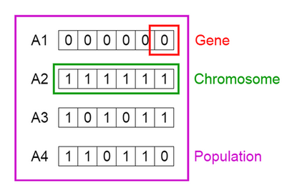
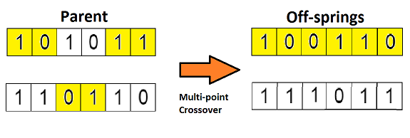
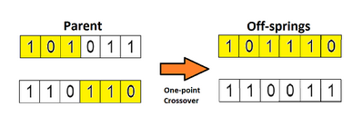
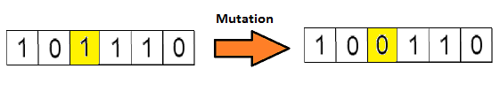
Foundation
Five phases are considered in a genetic algorithm.
Initial population
Fitness function
Selection
Crossover
Mutation

Slide 4
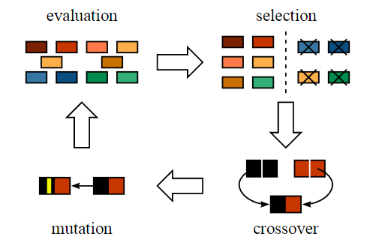

Slide 5
Stopping Conditions for the Algorithm
1. Generations
2. Time limit
3. Fitness limit
4. No Improvement
…

Slide 6
Examples
1. create target string, starting from random string
2. n queen

